Slide 1
Multithreading
Asma Kanwal
Lecturer
Department of Computer Science
GC University, Lahore

Slide 2
Introduction
“threads of execution,” each thread designating a portion of a program that may execute concurrently with other threads—this capability is called multithreading.
Concurrency using synchoronization.

Slide 3
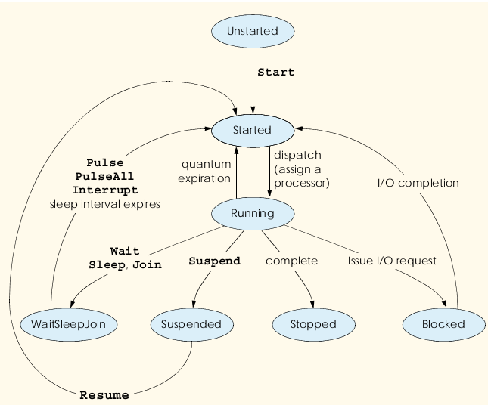
Threads Life Cycle

Slide 4
Threads Life Cycle Description
Start State: Ready or Runnable state
Running State: Operating system assigns a processor to the thread. When a program creates a new Thread , the program specifies the Thread ’s ThreadStart delegate as the argument to the Thread constructor.
Stopped State: ThreadStart delegate terminates.
Method Abort throws a ThreadAbortException in the thread, normally causing the thread to terminate
Blocked State: Thread issues an input/output request. The operating system blocks the thread from executing until the operating system can complete the I/O for which the thread is waiting.

Slide 5
Threads Life Cycle Description
WaitSleepJoin state:
Thread encounters code that it cannot execute yet the thread can call Monitor method Wait to enter the WaitSleepJoin state.
Monitor method Pulse or PulseAll. Method Pulse moves the next waiting thread back to the Started state. Method PulseAll moves all waiting threads back to the Started state.
A Running thread can call Thread method Sleep to enter the WaitSleepJoin state. WaitSleepJoin state for a period of milliseconds specified as the argument to Sleep. A sleeping thread returns to the Started state when its designated sleep time expires. Sleeping threads cannot use a processor, even if one is available.

Slide 6
Threads Life Cycle Description
Suspended State: A Suspended thread returns to the Started state when another thread in the program invokes the Suspended thread’s Resume method.

Slide 7
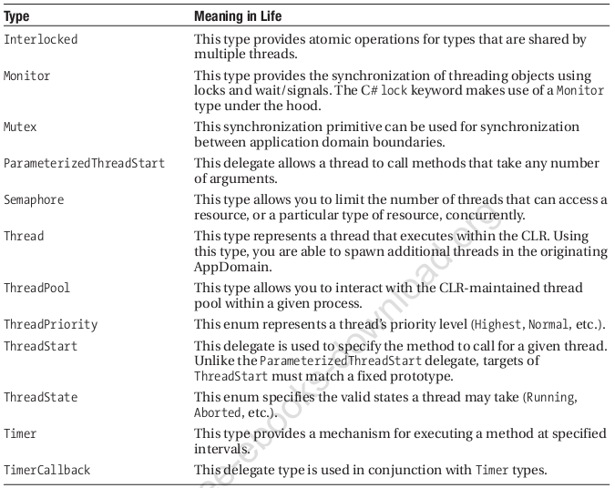
System.Threading namespace

Slide 8
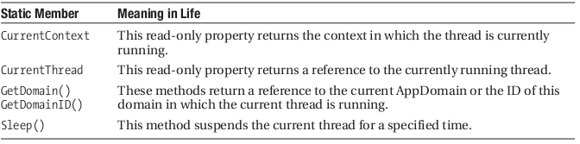
Thread Static Member

Slide 9
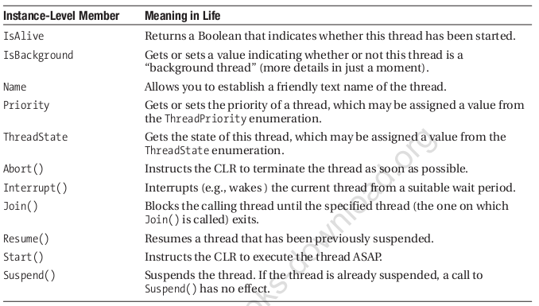
Instance Level Member

Slide 10
Example
public class Mythread
{
public static void Thread1()
{
for (int i = 0; i < 10; i++)
{
Console.WriteLine("Thread1 {0}", i);
}
}
public static void Thread2()
{
for (int i = 0; i < 10; i++)
{
Console.WriteLine("Thread2 {0}", i);
}
}
}

Slide 11
Example
static void Main(string[] args)
{
Console.WriteLine("Before start thread");
// Thread tid1 = new Thread(new ThreadStart(Mythread.Thread1));
// Thread tid2 = new Thread(new ThreadStart(Mythread.Thread2));
Thread tid1 = new Thread(Mythread.Thread1);
Thread tid2 = new Thread(Mythread.Thread2);
tid1.Start();
tid2.Start();
// tid1
Console.Read();
}

Slide 12
Monitor example
using System; using System.Threading; namespace waitndpulesmethod { class TickTock { public void tick(bool running) { lock (this) { if (!running) { // stop the clock Monitor.Pulse(this); // notify any waiting threads return; } Console.Write("Tick "); Monitor.Pulse(this); // let tock() run Monitor.Wait(this); // wait for tock() to complete } }

Slide 13
Monitor example
public void tock(bool running) { lock (this) { if (!running) { // stop the clock Monitor.Pulse(this); // notify any waiting threads | return; } Console.WriteLine("Tock"); Monitor.Pulse(this); // let tick() run Monitor.Wait(this); // wait for tick() to complete } } }

Slide 14
Monitor example
class MyThread { public Thread thrd; TickTock ttOb; // Construct a new thread. public MyThread(string name, TickTock tt) { thrd = new Thread(this.run); ttOb = tt; thrd.Name = name; thrd.Start(); } // Begin execution of new thread. void run() { if (thrd.Name == "Tick") { for (int i = 0; i < 5; i++) ttOb.tick(true); ttOb.tick(false); } else { for (int i = 0; i < 5; i++) ttOb.tock(true); ttOb.tock(false); } } }

Slide 15
Monitor example
class TickingClock { public static void Main() { TickTock tt = new TickTock(); MyThread mt1 = new MyThread("Tick", tt); MyThread mt2 = new MyThread("Tock", tt); mt1.thrd.Join(); mt2.thrd.Join(); Console.WriteLine("Clock Stopped"); Console.Read(); } } }

